Slide 1
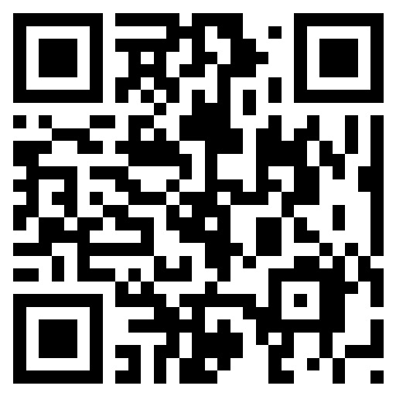
Making it Safe
Pamela Woll, MA, CPS
Senior Consultant
African American Behavioral Health Center of Excellence
Morehouse School of Medicine
https://africanamericanbehavioralhealth.org/

Slide 2
z
A Trauma-Informed Approach

Slide 3
Personal Agreement Provided courtesy Mark Sanders, LCSW, CADC
I, _____________________
Understand that it is okay to be imperfect in my understanding of people who are different from me
Have permission to reveal ignorance and misunderstanding
Have permission to struggle with these issues and be up-front and honest about my feelings

Slide 4
Personal Agreement (Mark Sanders, Continued)
I am a product of my culture, upbringing, environment, and experiences, and I am who I am. I do not have to feel guilty about what I believe, but I do take responsibility for:
Accepting as much new information and knowledge as I can
Challenging myself to examine my assumptions and beliefs
Granting permission to the other members of the group to struggle with these issues and to be open and honest about their feelings
Agreeing to respect the confidentiality of all the personal information shared in the group

Slide 5
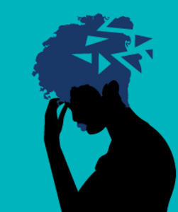
Racism is Trauma What variety of “otherism” would not be trauma?

Slide 6
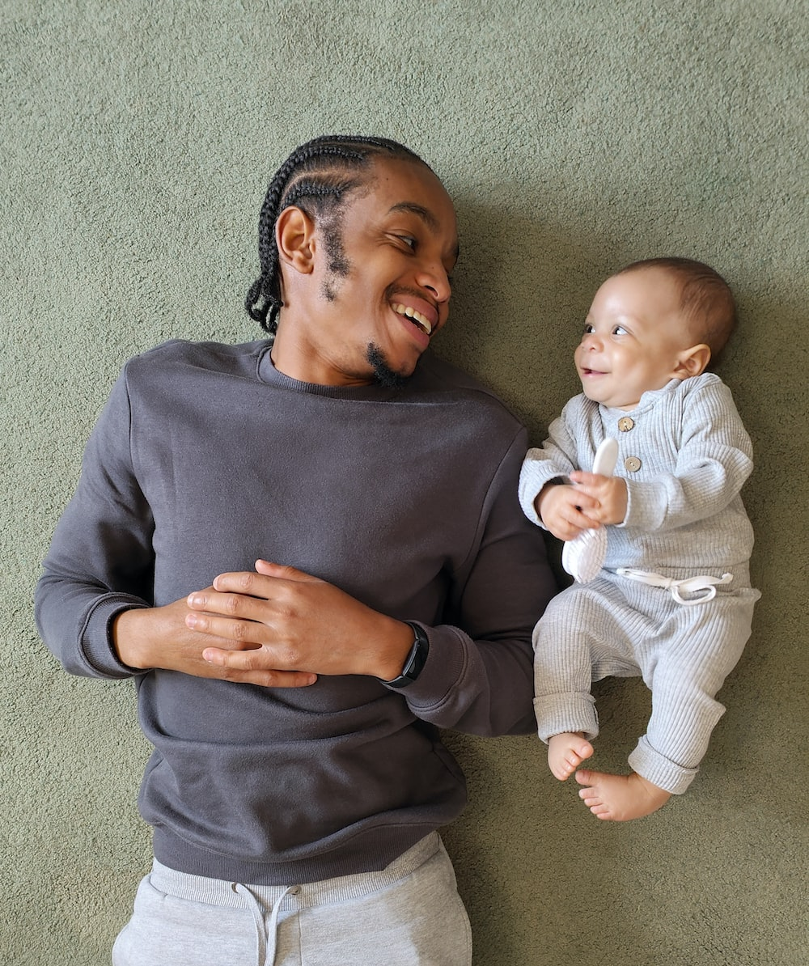
We all Need… …Love and Belonging
z

Slide 7
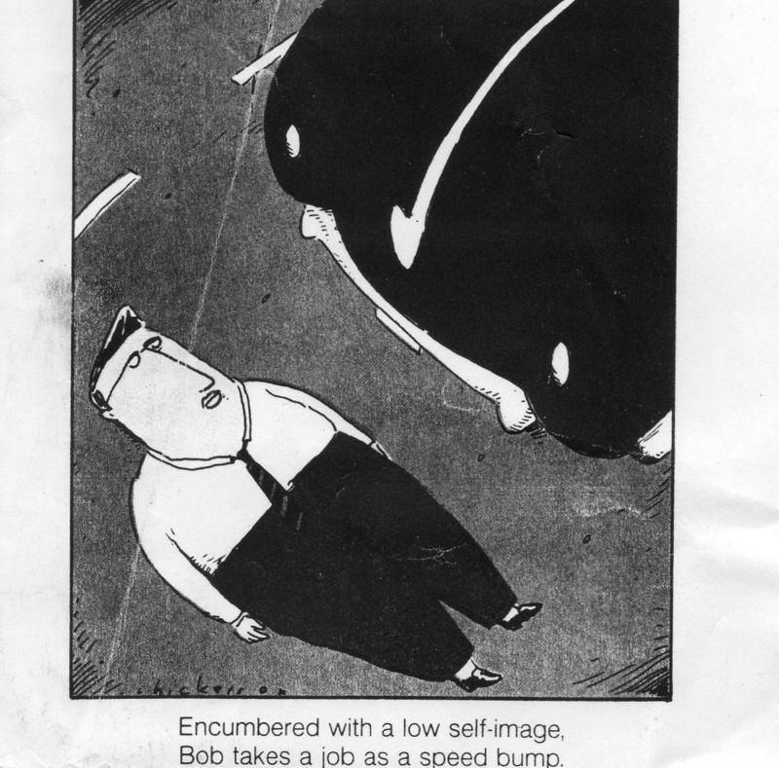
What experiences might people bring when it comes to:
What they can and can’t talk about?
The dominant culture and world view?
Race, culture, color, gender, age, education, LGBTQ+, religion, recovery status?
“Differentness,” othering?
Trauma, loss, shame, anger, grief, guilt re: otherism?
Scary changes that challenge their sense of competence?

Slide 8
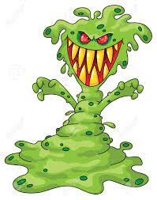
What are we afraid of?
z

Slide 9
The Limits of the Lens

Slide 10
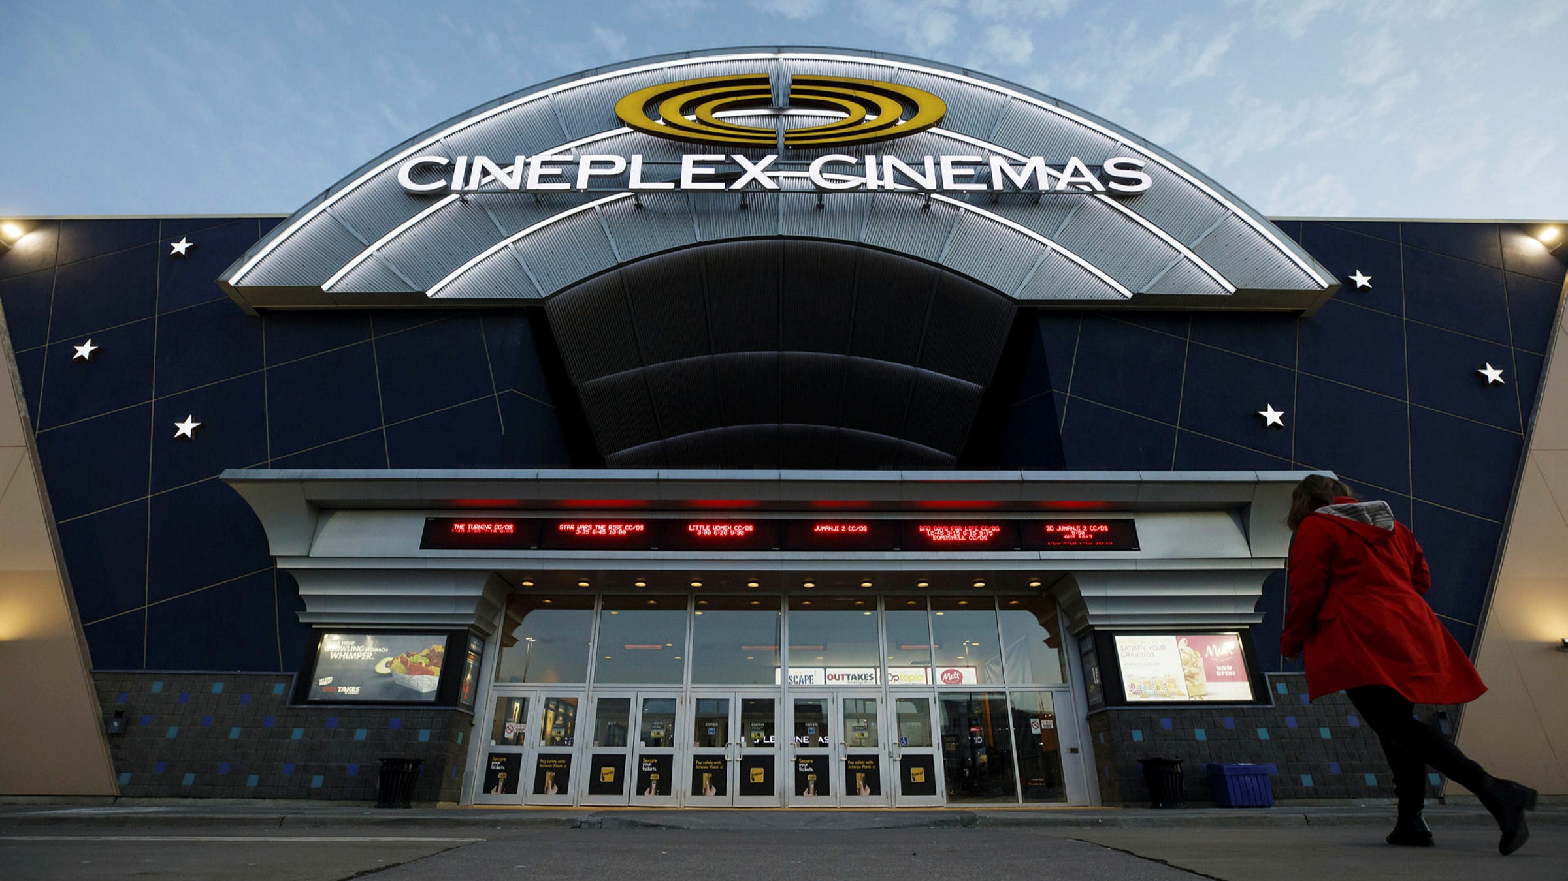
Cross-Cultural Safety

Slide 11
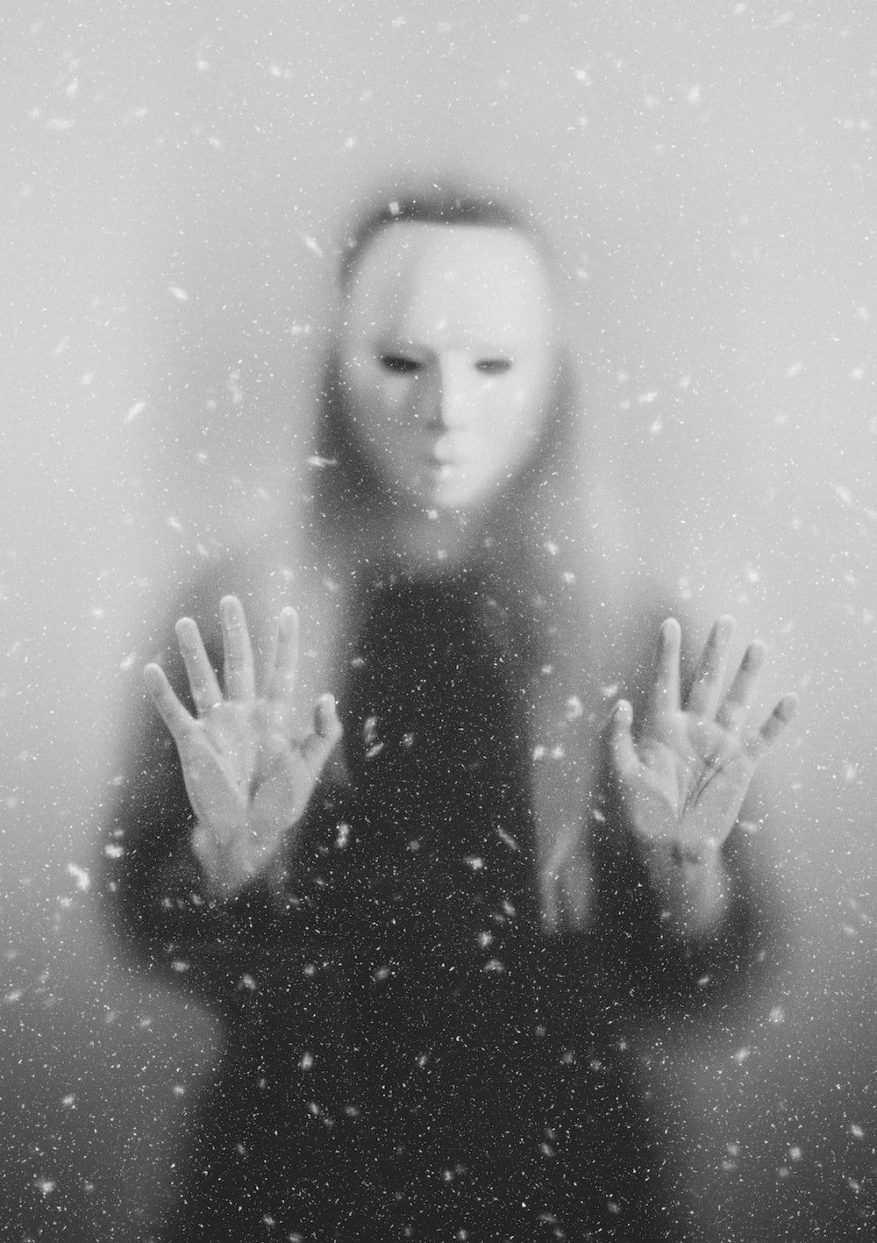
White Fragility
DiAngelo, 2018, 2021
Misunderstanding of “racism”
Denial/unawareness of socialization
Good/bad binary
Defensive reactions

Slide 12
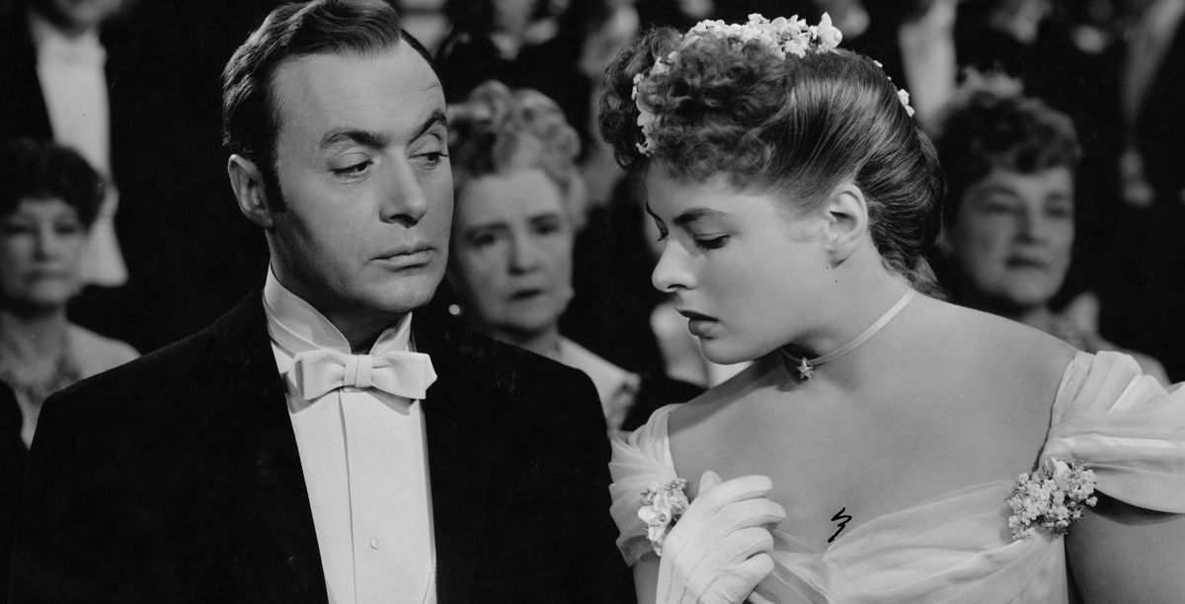
Gaslighting

Slide 13
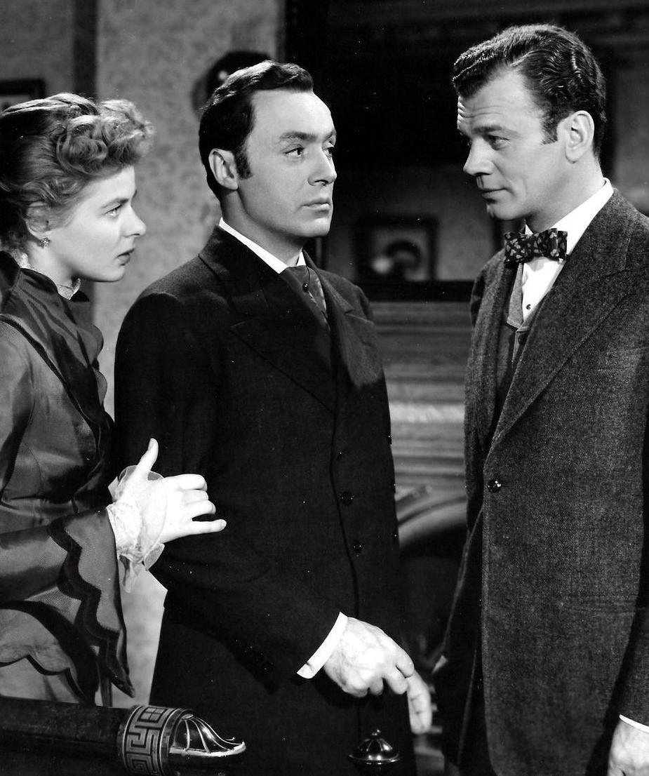
What if we were all Joseph Cotten?
z

Slide 14
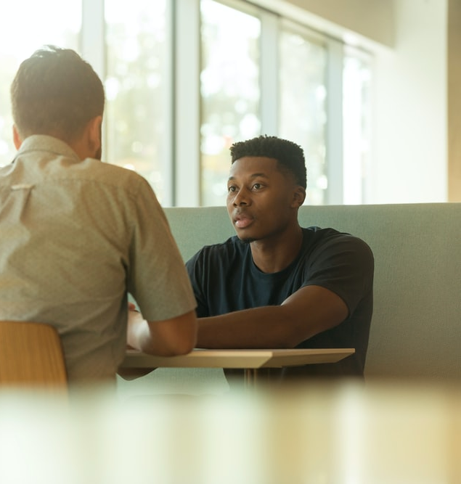
The power of telling the truth
z

Slide 15
It Should be Hard!

Slide 16
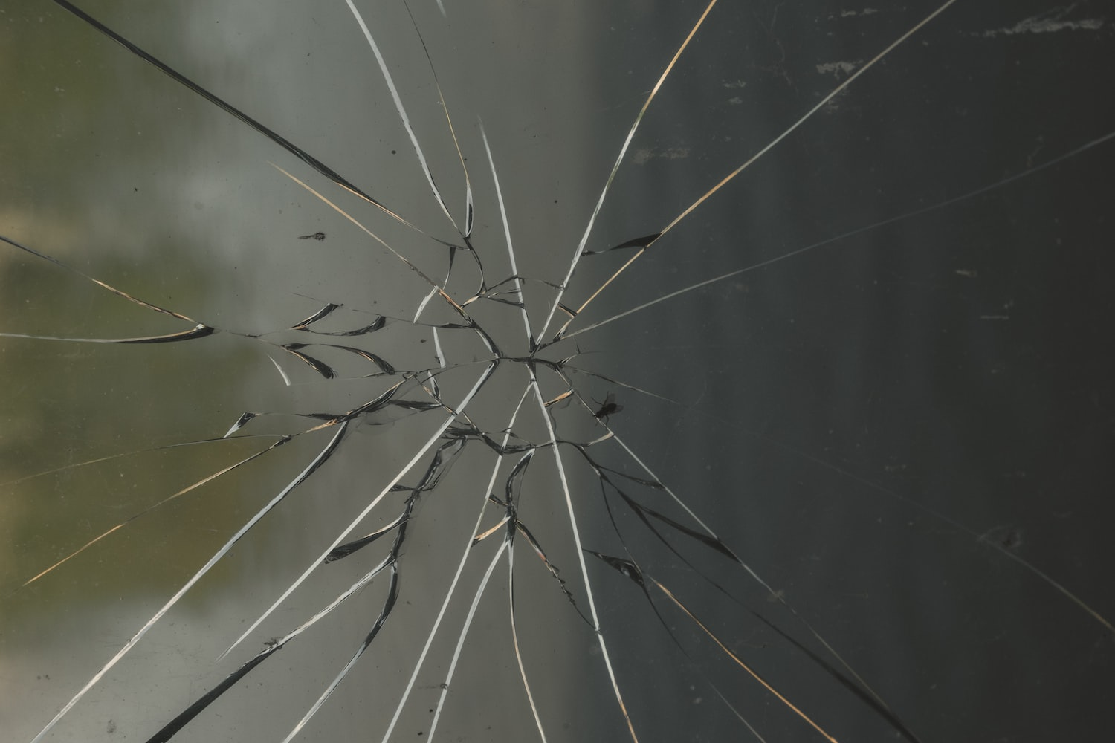
As long as we are on earth, the love that unites us will bring us suffering by our very contact with one another, because this love is the resetting of a body of broken bones.
—Thomas Merton

